Slide 1

Intake/Interview & Quality Review Sheet
IRS Form 13614-C

Slide 2
Intake/Interview & Quality Review Sheet (13614-C)
Basis for tax preparer/client interview
Completed by the client – Section A
  Page 1 - General information about taxpayer, spouse and dependents. Entered on “Main Information Sheet” in TaxWise
  Page 2 - Summary of income, expenses, and life events and Presidential Election Campaign Fund question
  Page 3 – Additional Information & Questions (grant money questions, refund and balance due, and taxpayer comments)
Completed by preparer
  Page 4, Section B– Questions about dependents
  Page 4 – Tax Preparer Notes
Completed by quality reviewer
  Page 4, Section C
Notes:
Post a copy of the Intake Form on the web site so that students can print it or look at it full screen.

Slide 3
Intake Sheet Page 1
Personal Information

Slide 4
Intake Sheet Page 1 Family & Dependent Information

Slide 5
Intake Sheet Page 2
Income

Slide 6
Intake Sheet Page 2
Expenses

Slide 7
Intake Sheet Page 2
Life Events

Slide 8
Intake Sheet Page 2-Presidential Election Campaign Fund Question

Slide 9
Intake Sheet Page 3 Additional Information

Slide 10
Intake Sheet Page 3 Additional Information –Refund or Balance Due Options

Slide 11
Intake Sheet Page 3 Additional Information –Taxpayer Comments

Slide 12
Intake Sheet Page 4
Dependent Questions

Slide 13
Intake Sheet Page 4
Quality Review

Slide 14
Intake Sheet Page 4
Preparer Notes

Slide 15
Summary
The Intake Sheet is completed by the taxpayer and reviewed with the taxpayer prior to entering any information into TaxWise Software.
The Intake Sheet is kept by the taxpayer

Slide 16
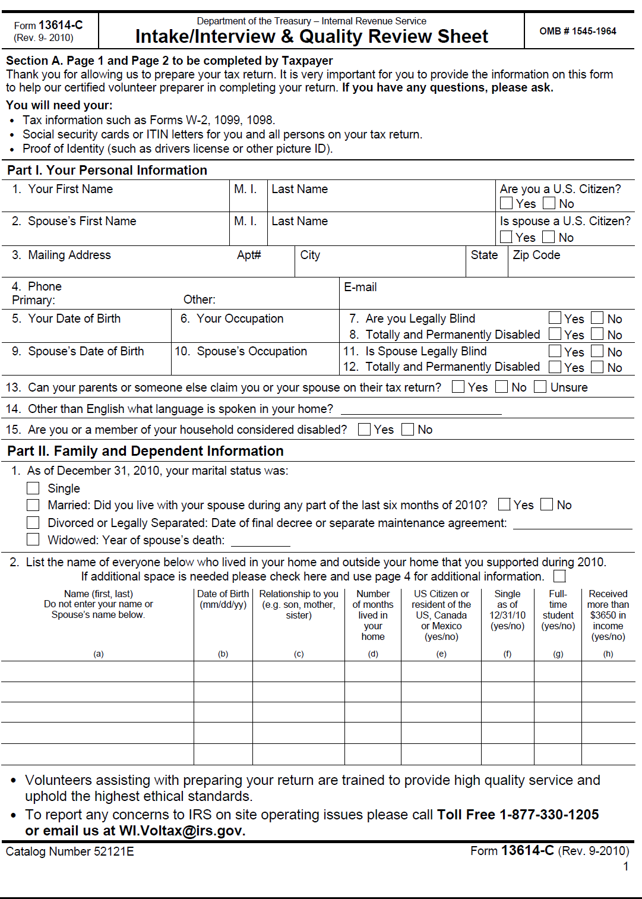
Intake Form Page 1
Notes:
Post a copy of the Intake Form on the web site so that students can print it or look at it full screen.

Slide 17
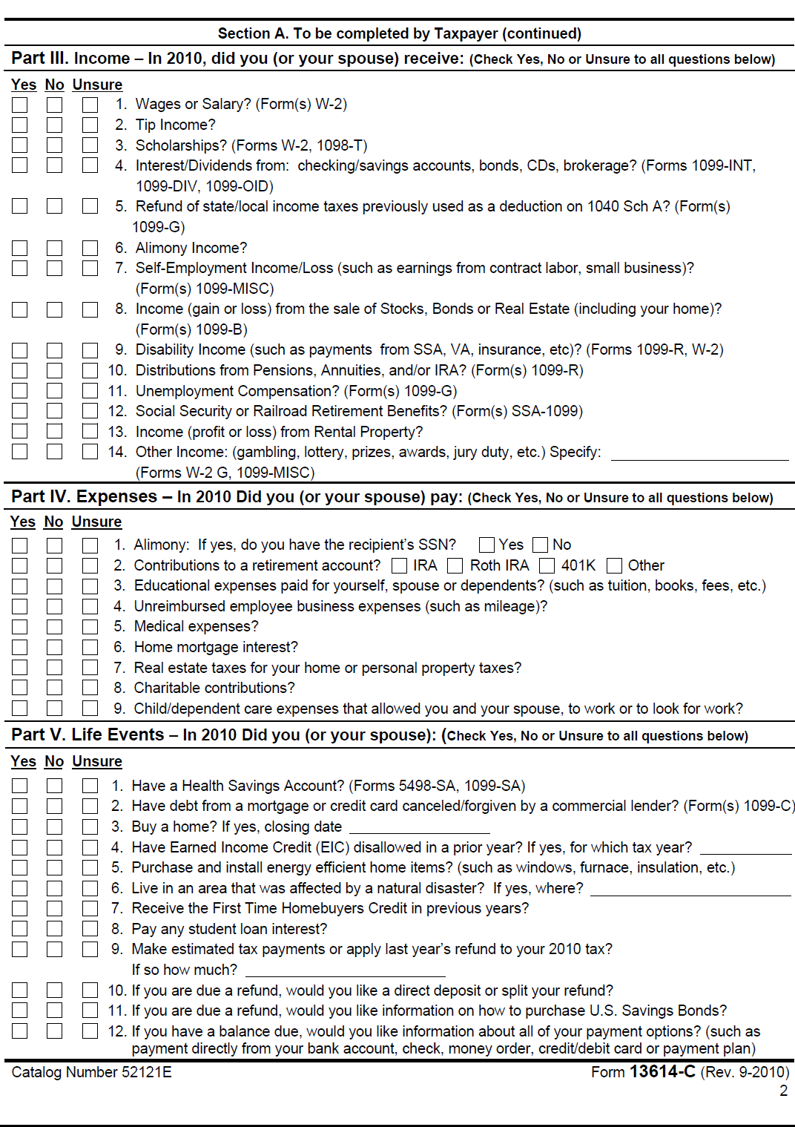
Intake Form Page 2

Slide 18
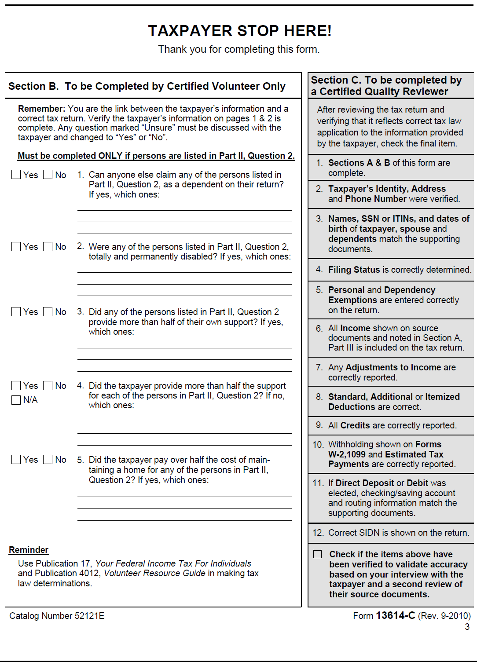
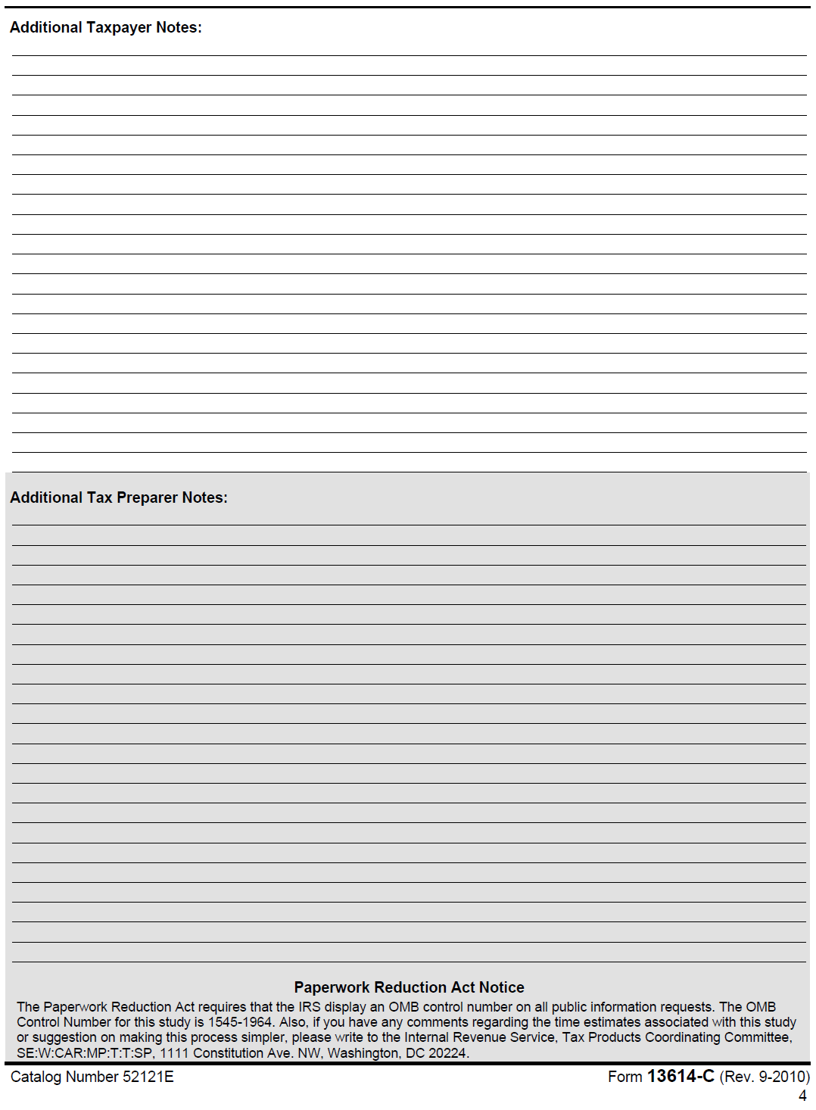
Intake Form Pages 3 & 4

